Slide 1
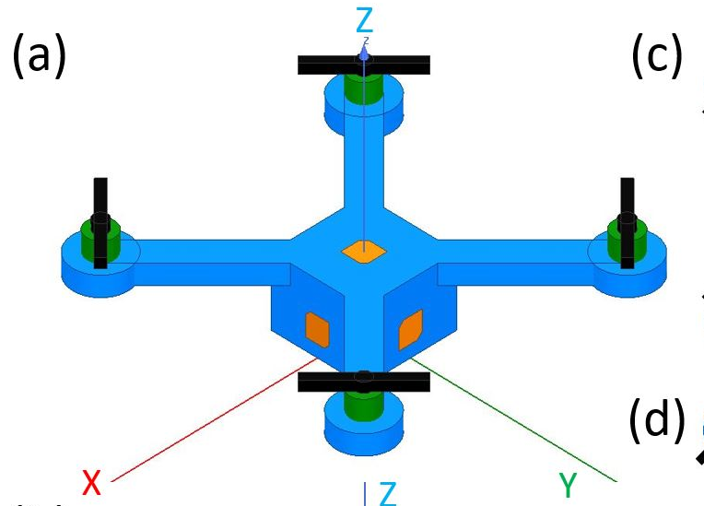
Integrated Sensing System for Agricultural Application
R09942006 Shih-Ming Huang

Slide 2
Outline
Overview of Integrated Sensing System
Survey of P-Band Radar System
Prior-Art of Wireless Power Transfer Sensors on UHF Band (300 MHz ~ 3GHz)

Slide 3
System Overview
L-Band Radar
Biomass
Crop Classification
Soil Moisture
Wireless Power Transfer
Temperature
Chemical Composition
PH value
Soil
UHF-Powered Sensor

Slide 4
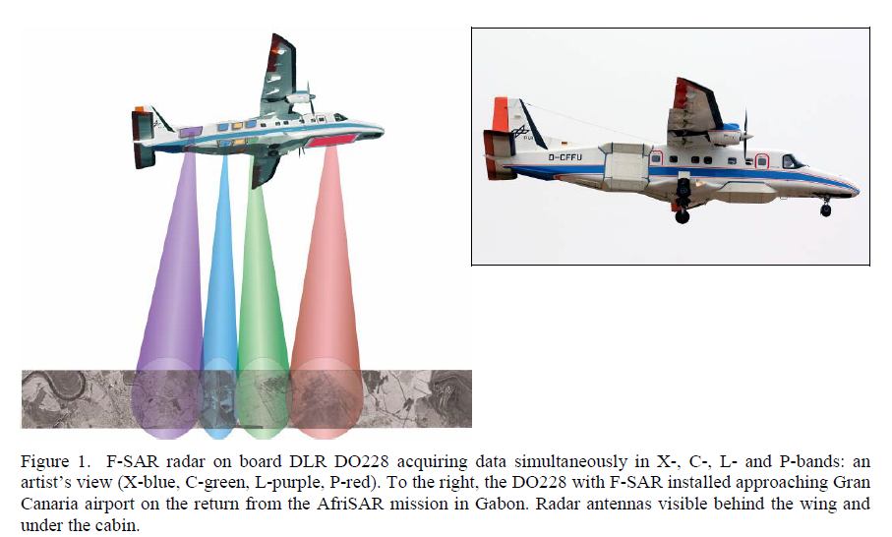
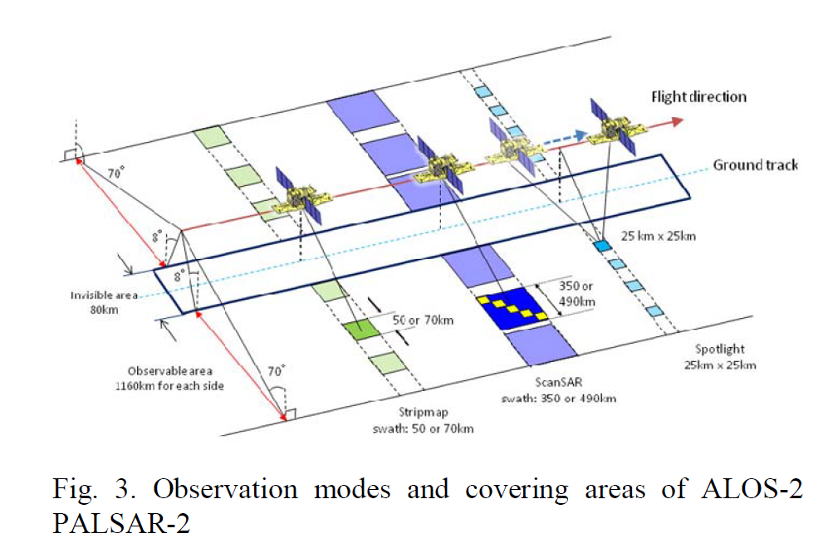
L-Band Radar Application
Advanced Land Observing Satellite-2 (ALOS-2) and its follow-on L-band SAR mission (2017)
L-Band Antenna Array for Next Generation DLR Airborne SAR Sensor (2019)
Soil Moisture Retrieval During a Corn Growth Cycle Using L-Band (1.6 GHz) Radar Observations (2008)

Slide 5
P-Band Radar Application
Phenomenology of P-Band Scattering From a Tropical Forest Through Three-Dimensional SAR Tomography (2012)
Polarimetric 3-D Reconstruction From Multicircular SAR at P-Band (2014)
Toward P-Band Passive Microwave Sensing of Soil Moisture (2020)

Slide 6
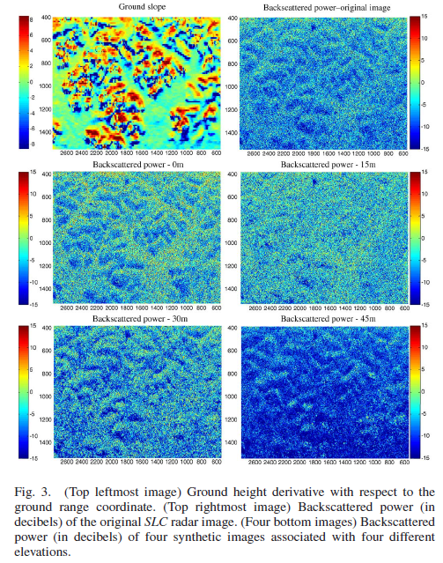
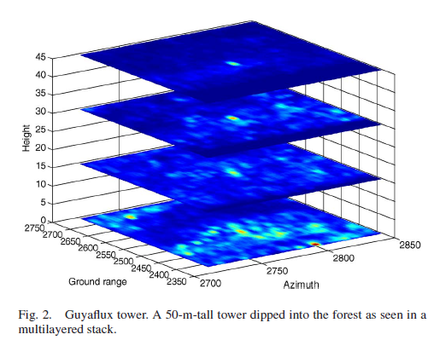
Phenomenology of P-Band Scattering From a Tropical Forest Through Three-Dimensional SAR Tomography (2012)
P-band SAR image from 20- to 40-meter-height forest
Multi-Pass SAR image from TropiSAR (airplane)
20-meter vertical resolution
Non-Optimization algorithm

Slide 7
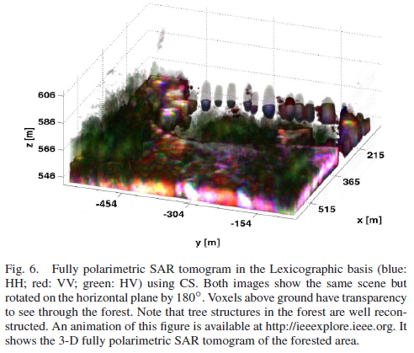
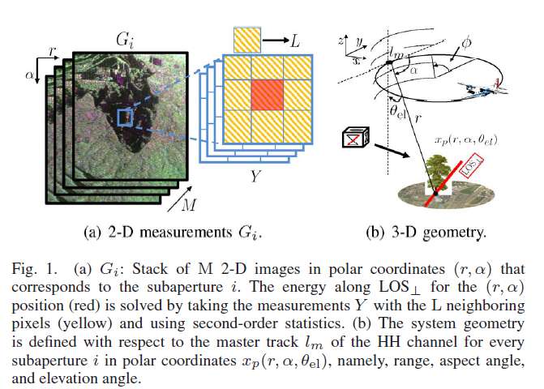
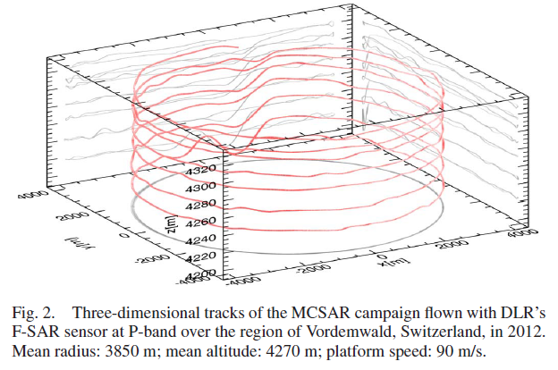
Polarimetric 3-D Reconstruction From Multicircular SAR at P-Band (2014)
Multicircular SAR

Slide 8
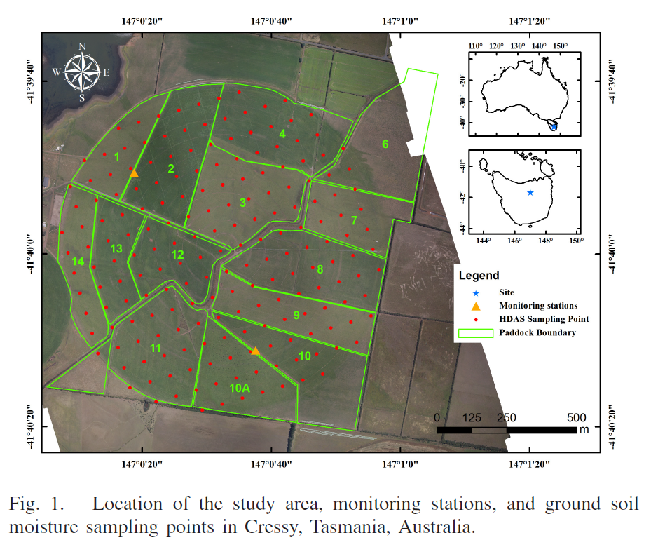
Toward P-Band Passive Microwave Sensing of Soil Moisture (2020)
L-band (1.4 GHz) & P-band (750 MHz) radiometer
HDAS system as ground truth
P-band could retrieval of soil moisture
Less susceptible to vegetation coverage
Deeper soil moisture information (~10cm)

Slide 9
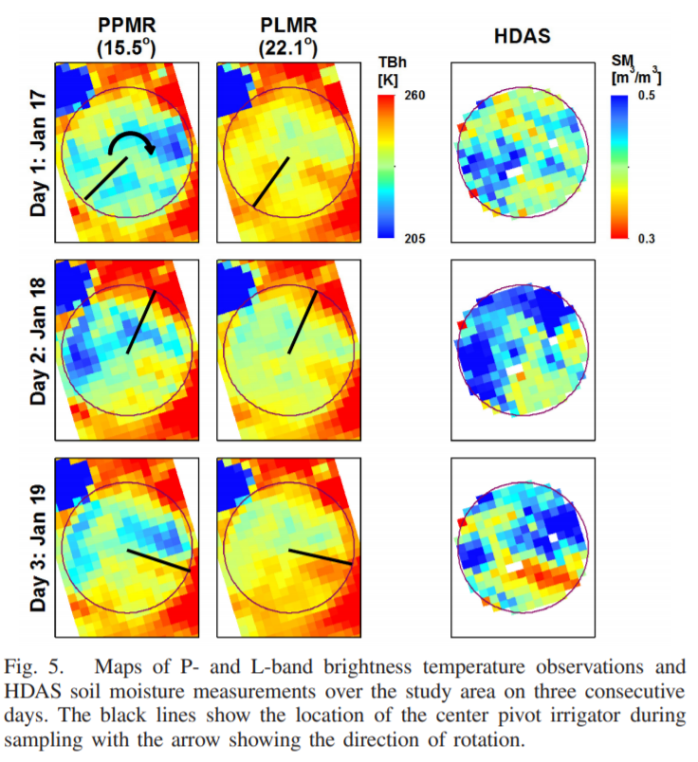
Toward P-Band Passive Microwave Sensing of Soil Moisture (2020)
L-band (1.4 GHz) & P-band (750 MHz) radiometer
HDAS system as ground truth
P-band could retrieval of soil moisture
Less susceptible to vegetation coverage
Deeper soil moisture information (~10cm) than L-band (~5cm)

Slide 10
Wireless Power Transfer Sensors (UHF)
Design of an RFID-Based Battery-Free Programmable Sensing Platform (2008)
An UHF RFID Energy-Harvesting System Enhanced by a DC-DC Charge Pump in Silicon-on-Insulator Technology (2013)

Slide 11
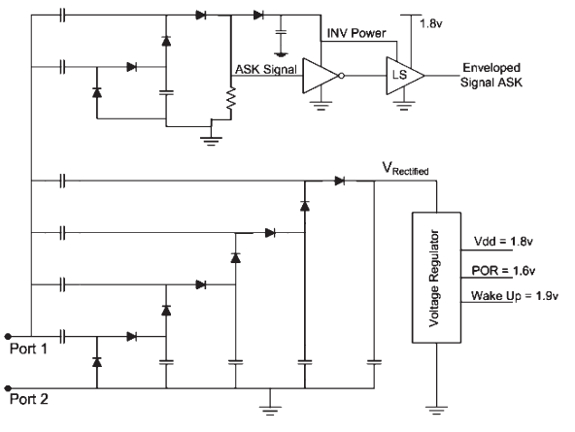
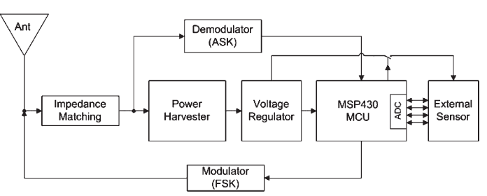
Design of an RFID-Based Battery-Free Programmable Sensing Platform (2008)

Slide 12
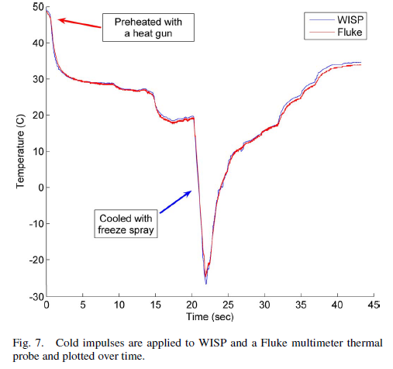
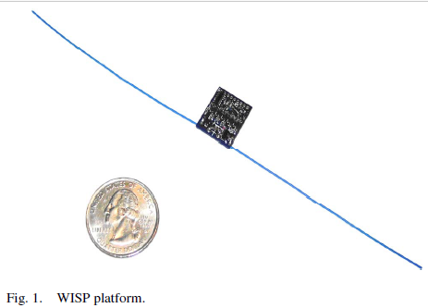
Design of an RFID-Based Battery-Free Programmable Sensing Platform (2008)

Slide 13
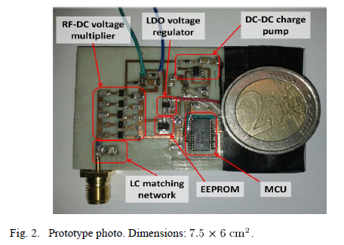
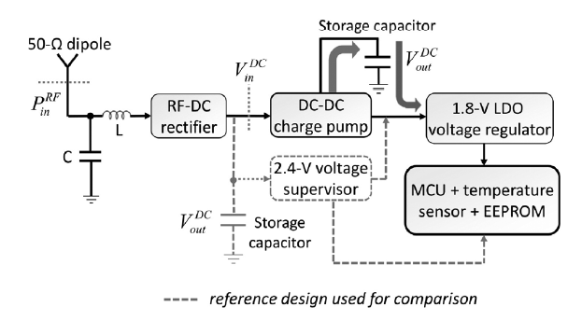
An UHF RFID Energy-Harvesting System Enhanced by a DC-DC Charge Pump in Silicon-on-Insulator Technology (2013)

Slide 14
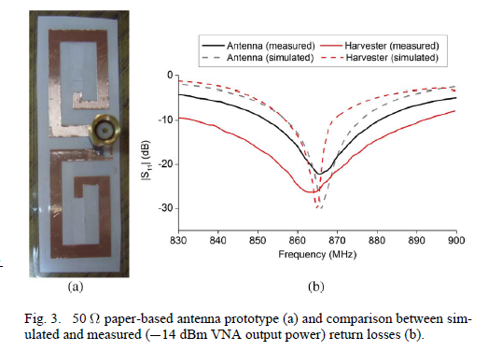
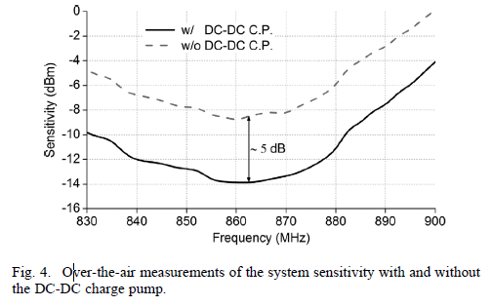
An UHF RFID Energy-Harvesting System Enhanced by a DC-DC Charge Pump in Silicon-on-Insulator Technology (2013)

Slide 15
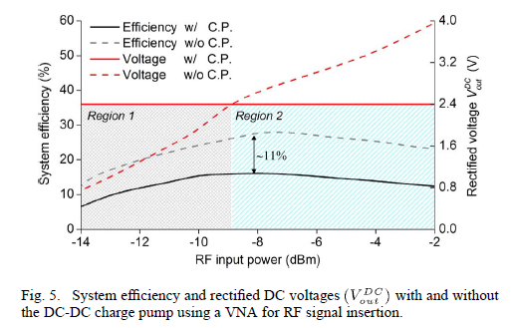
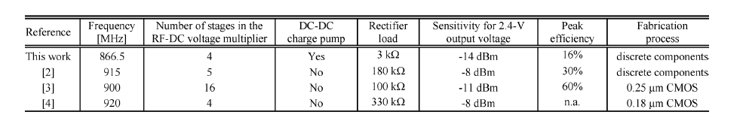
An UHF RFID Energy-Harvesting System Enhanced by a DC-DC Charge Pump in Silicon-on-Insulator Technology (2013)

